Slide 1



PIZZA
SALES
By - Gauri Raykar

Slide 2

DATASETS
Project Name : Pizza Sales Analysis
Dataset Name : pizzas, orders, order_details, pizza_types
Dataset Size : 97, 21k, 48k & 33 respectively
Dataset Types : Excel Data

Slide 3

3.
Identify the highest-priced pizza.
5.
List the top 5 most ordered pizza types along with their quantities.
Retrieve the total number of orders placed.
Calculate the total revenue generated from pizza sales.
4.
Identify the most common pizza size ordered.

Slide 4
6.
Join the necessary tables to find the total quantity of each pizza category ordered.
8.
Join relevant tables to find the category-wise distribution of pizzas.
10.
Determine the top 3 most ordered pizza types based on revenue.
9.
Group the orders by date and calculate the average number of pizzas ordered per day.
7.
Determine the distribution of orders by hour of the day.

Slide 5
12.
Analyze the cumulative revenue generated over time.
13.
Determine the top 3 most ordered pizza types based on revenue for each pizza category.
11.
Calculate the percentage contribution of each pizza type to total revenue.

Slide 6
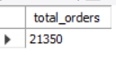
Retrieve the total number of orders placed.
SELECT
COUNT(order_id) AS total_orders
FROM
orders;

Slide 7
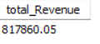
Calculate the total revenue generated from pizza sales.
SELECT
ROUND(SUM(order_details.quantity * pizzas.price),
2) AS total_Revenue
FROM
order_details
JOIN
pizzas ON pizzas.pizza_id = order_details.pizza_id;

Slide 8

3.
Identify the highest-priced pizza.
SELECT
pizza_types.name, pizzas.price
FROM
pizza_types
JOIN
pizzas ON pizza_types.pizza_type_id = pizzas.pizza_type_id
ORDER BY pizzas.price DESC
LIMIT 1;

Slide 9
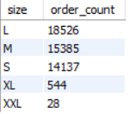
4.
Identify the most common pizza size ordered.
SELECT
pizzas.size,
COUNT(order_details.order_details_id) AS order_count
FROM
pizzas
JOIN
order_details ON pizzas.pizza_id = order_details.pizza_id
GROUP BY pizzas.size
ORDER BY order_count DESC;

Slide 10
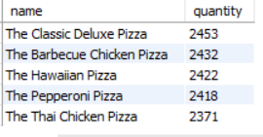
5.
List the top 5 most ordered pizza types along with their quantities.
SELECT
pizza_types.name, SUM(order_details.quantity) AS quantity
FROM
pizza_types
JOIN
pizzas ON pizza_types.pizza_type_id = pizzas.pizza_type_id
JOIN
order_details ON order_details.pizza_id = pizzas.pizza_id
GROUP BY pizza_types.name
ORDER BY quantity DESC
LIMIT 5;

Slide 11
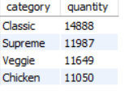
6.
Join the necessary tables to find the total quantity of each pizza category ordered.
SSELECT
pizza_types.category,
SUM(order_details.quantity) AS quantity
FROM
pizza_types
JOIN
pizzas ON pizza_types.pizza_type_id = pizzas.pizza_type_id
JOIN
order_details ON order_details.pizza_id = pizzas.pizza_id
GROUP BY pizza_types.category
ORDER BY quantity DESC;

Slide 12
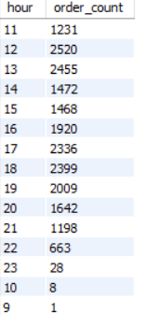
7.
Determine the distribution of orders by hour of the day.
SELECT
HOUR(order_time) AS hour, COUNT(order_id) AS order_count
FROM
orders
GROUP BY HOUR(order_time);

Slide 13
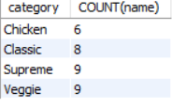
8.
Join relevant tables to find the category-wise distribution of pizzas.
SELECT
category, COUNT(name)
FROM
pizza_types
GROUP BY category;

Slide 14
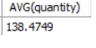
9.
Group the orders by date and calculate the average number of pizzas ordered per day.
SELECT
AVG(quantity)
FROM
(SELECT
orders.order_date, SUM(order_details.quantity) AS quantity
FROM
orders
JOIN order_details ON orders.order_id = order_details.order_id
GROUP BY orders.order_date) AS order_quantity;

Slide 15
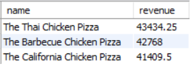
10.
Determine the top 3 most ordered pizza types based on revenue.
SELECT
pizza_types.name,
SUM(order_details.quantity * pizzas.price) AS revenue
FROM
pizza_types
JOIN
pizzas ON pizzas.pizza_type_id = pizza_types.pizza_type_id
JOIN
order_details ON order_details.pizza_id = pizzas.pizza_id
GROUP BY pizza_types.name
ORDER BY revenue DESC
LIMIT 3;

Slide 16
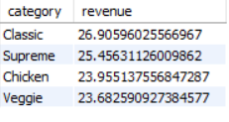
11.
Calculate the percentage contribution of each pizza type to total revenue.
SELECT
pizza_types.category,
SUM(order_details.quantity * pizzas.price) / (SELECT
ROUND(SUM(order_details.quantity * pizzas.price),
2) AS total_Revenue
FROM
order_details
JOIN
pizzas ON pizzas.pizza_id = order_details.pizza_id) * 100 AS revenue
FROM
pizza_types
JOIN
pizzas ON pizza_types.pizza_type_id = pizzas.pizza_type_id
JOIN
order_details ON order_details.pizza_id = pizzas.pizza_id
GROUP BY pizza_types.category
ORDER BY revenue DESC;

Slide 17
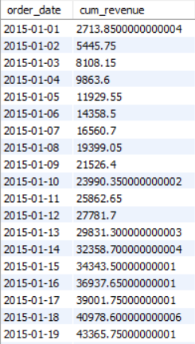
12.
Analyze the cumulative revenue generated over time.
select order_date, sum(revenue) over(order by order_Date) as cum_revenue
from (select orders.order_date, sum(order_details.quantity*pizzas.price) as revenue
from order_details join pizzas
on order_details.pizza_id = pizzas.pizza_id join orders
on orders.order_id = order_details.order_id group by orders.order_date) as sales;

Slide 18
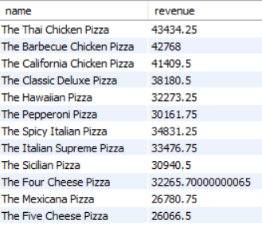
13.
Determine the top 3 most ordered pizza types based on revenue for each pizza category.
select name, revenue from
(select category, name, revenue, rank() over
(partition by category order by revenue desc) as rn
from (select pizza_types.category, pizza_types.name,
sum((order_details.quantity) * pizzas.price) as revenue
from pizza_types join pizzas
on pizza_types.pizza_type_id = pizzas.pizza_type_id
join order_details
on order_details.pizza_id = pizzas.pizza_id
group by pizza_types.category, pizza_types.name) as a) as b
where rn<=3;

Slide 19
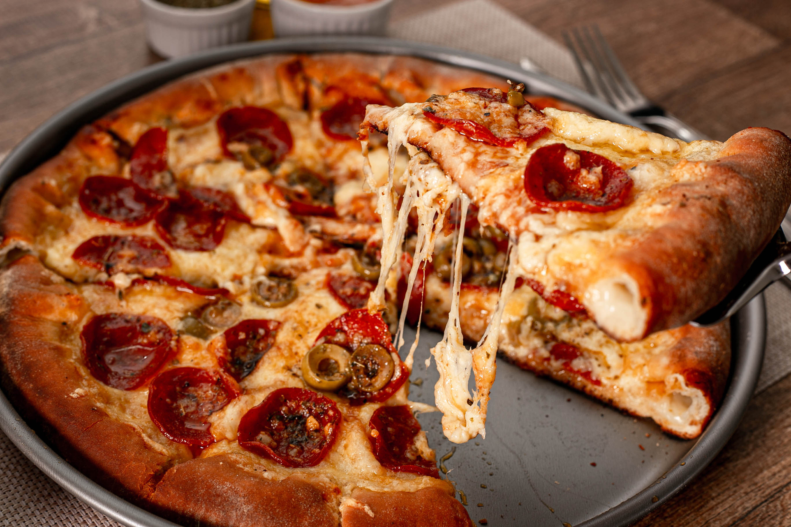
THANK YOU

